Slide 1
Unit 2-1
Midpoint and Distance
PLANE Geometry

Slide 2
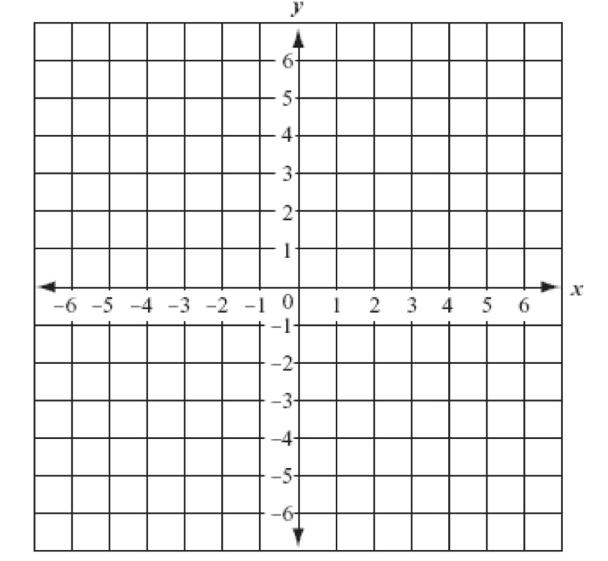
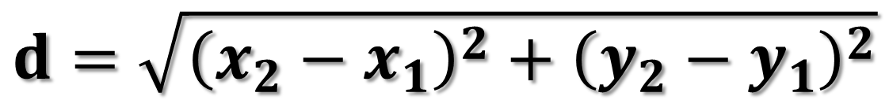
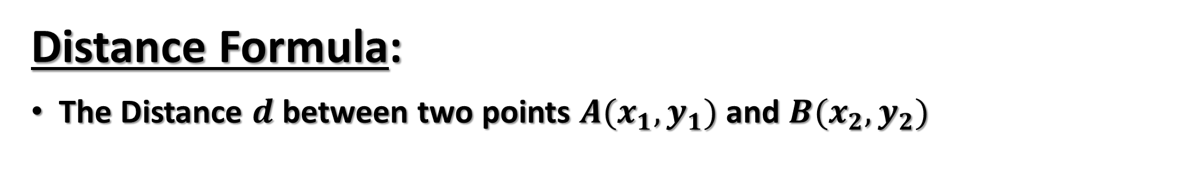
Distance Formula:
The Distance $d$ between two points $A(x_{1}, y_{1})$ and $B(x_{2},y_{2})$
$$d=\sqrt{{\left(x_{2}−x_{1}\right)}^{2}+{\left(y_{2}−y_{1}\right)}^{2}}$$
B
A

Slide 3

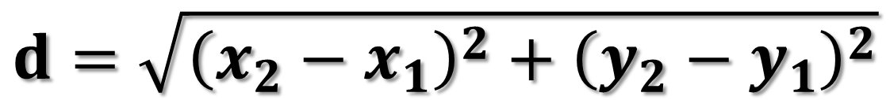
Example 1
Find the Distance Between $A(5, −2)$ and $B(1,3)$.
$$d=\sqrt{{\left(x_{2}−x_{1}\right)}^{2}+{\left(y_{2}−y_{1}\right)}^{2}}$$

Slide 4

Example 2
Find the Distance Between $A(5, 9)$ and $B(7,4)$.
$$d=\sqrt{{\left(x_{2}−x_{1}\right)}^{2}+{\left(y_{2}−y_{1}\right)}^{2}}$$

Slide 5

Midpoint Formula:
The Midpoint $M$ between two points $A(x_{1}, y_{1})$ and $B(x_{2},y_{2})$
$$M\left(x_{m},y_{m}\right) where x_{m}=\frac{x_{1}+x_{2}}{2} and y_{m}=\frac{y_{1}+y_{2}}{2}$$
A
B

Slide 6

Example 3
Find the Midpoint Between $A(3, 5)$ and $B(7,2)$.
$$M\left(x_{m},y_{m}\right) where x_{m}=\frac{x_{1}+x_{2}}{2} and y_{m}=\frac{y_{1}+y_{2}}{2}$$

Slide 7
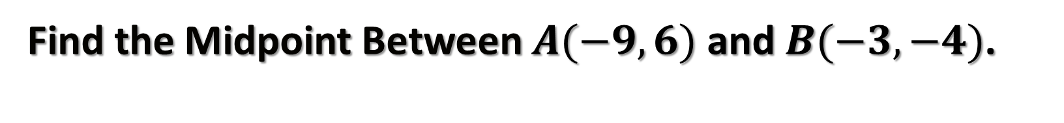
Example 4
Find the Midpoint Between $A(−9, 6)$ and $B(−3,−4)$.
$$M\left(x_{m},y_{m}\right) where x_{m}=\frac{x_{1}+x_{2}}{2} and y_{m}=\frac{y_{1}+y_{2}}{2}$$

Slide 8
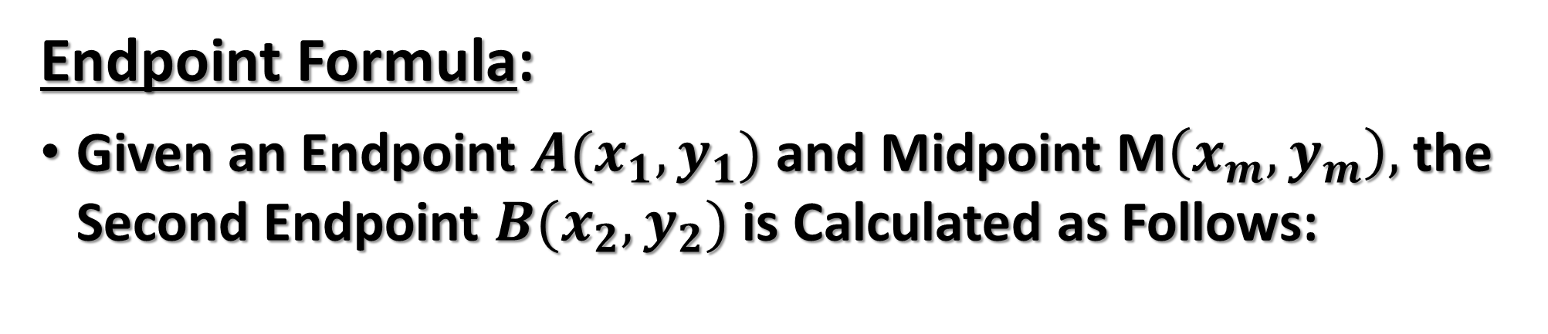
Endpoint Formula:
Given an Endpoint $A(x_{1}, y_{1})$ and Midpoint M$\left(x_{m},y_{m}\right),$ the Second Endpoint $B(x_{2},y_{2})$ is Calculated as Follows:
$$x_{2}=2x_{m}−x_{1} and y_{2}=2y_{m}−y_{1}$$
A
B
M

Slide 9
Example 5
Find the Endpoint Given Endpoint $A(2, 0)$ and $Midpoint M(7,−3)$.
$$E\left(x_{2},y_{2}\right) where x_{2}=2x_{m}−x_{1} and y_{2}=2y_{m}−y_{1}$$

Slide 10
Example 6
Find the Endpoint Given Endpoint $A(4, 10)$ and $Midpoint M(−3,11)$.
$$E\left(x_{2},y_{2}\right) where x_{2}=2x_{m}−x_{1} and y_{2}=2y_{m}−y_{1}$$

